Slide 1
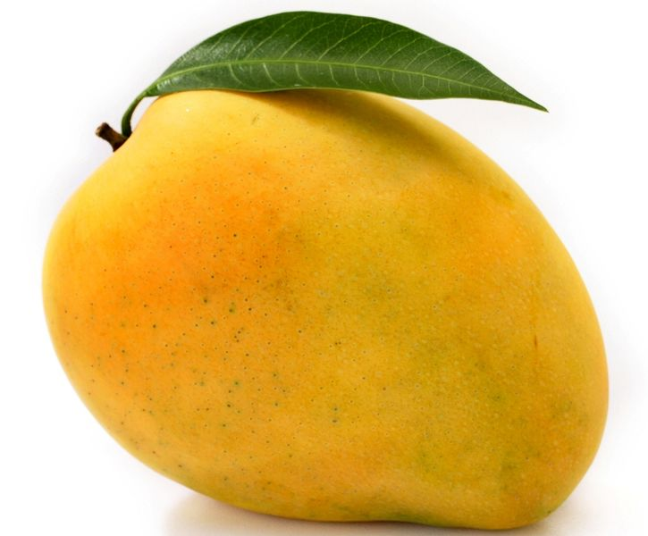
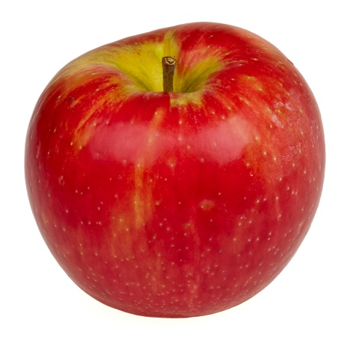

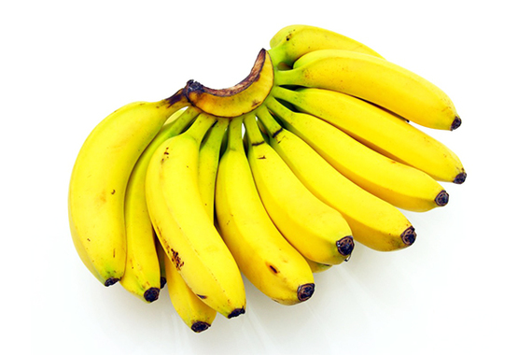
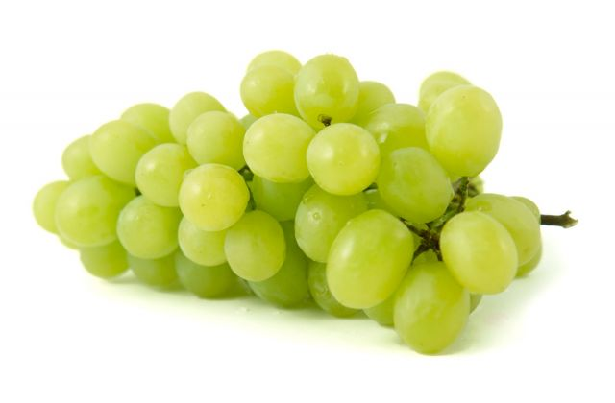
CLOSE
Reading Functional words (Fruits)
Mango
Apple
Banana
Grapes
Next

Slide 2
HOME
CLOSE
Reading functional words (Fruits - Mango)
Teaching Methodologies :
Introduction
Matching
Identification
Naming
Previous
Next

Slide 3
Introduction
MENU
CLOSE
Previous
MANGO
Next

Slide 4
MENU
CLOSE
Matching in one choice, two choice and multiple choice situations (Fruits - Mango)
Two choice
Three choice
Multiple choice
Previous
Next

Slide 5
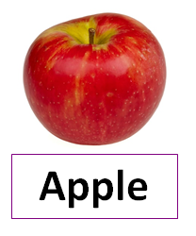
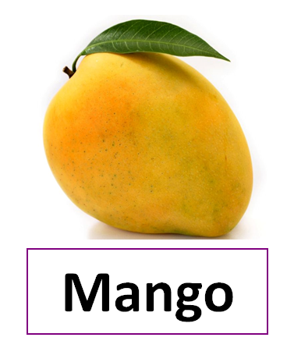
MENU
CLOSE
Match the word “Mango” from the options given to the right.
Previous
Next

Slide 6
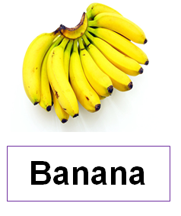
MENU
CLOSE
Match the word “Mango” from the options given in the bottom
Previous
Next

Slide 7
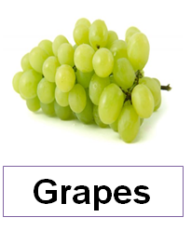
MENU
CLOSE
Match the word “Mango” from the options given in the bottom
Previous
Next

Slide 8
MENU
CLOSE
Match the word “Mango” from the options given bottom
Mango
Apple
Previous
Next

Slide 9
MENU
CLOSE
Match the word “Mango” from the options given in the bottom
Apple
Grapes
Mango
Previous
Next

Slide 10
MENU
CLOSE
Match the word “Mango” from the options given in the bottom
Mango
Mango
Apple
Previous
Next

Slide 11
MENU
CLOSE
Match the word “Mango” from the options given in the bottom
Mango
Mango
Papaya
Grapes
Previous
Next

Slide 12
MENU
CLOSE
Identification in one choice, two choice and multiple choice situation (Fruits - Mango)
One choice
Two choice
Multiple choice
Previous
Next

Slide 13
MENU
CLOSE
Identify the word “Mango” from the options given
Mango
Apple
Previous
Next

Slide 14
MENU
CLOSE
Identify the word “Mango” from the options given
Apple
Mango
Papaya
Previous
Next

Slide 15
MENU
CLOSE
Identify the word “Mango” from the options given
Apple
Grapes
Banana
Papaya
Mango
Previous
Next

Slide 16
MENU
CLOSE
Name this Fruit?
Mango
Previous
Next

Slide 17
MENU
CLOSE
Previous
Next

Slide 18
MENU
CLOSE
Read the following words
Fruits
Mango
Apple
Grapes
Papaya
Banana
Previous
Next

